Slide 1
Module 3: Frequency Based Substructuring

Slide 2
FBS: Outline
General introduction to FBS and the problem form
Deriving the FBS equations with simple math/physics
One-way FBS
Two-way FBS
Deriving the Lagrange multiplier FBS equations
Algebraic derivation
Constrained optimization (akin to Lagrangian mechanics)

Slide 3
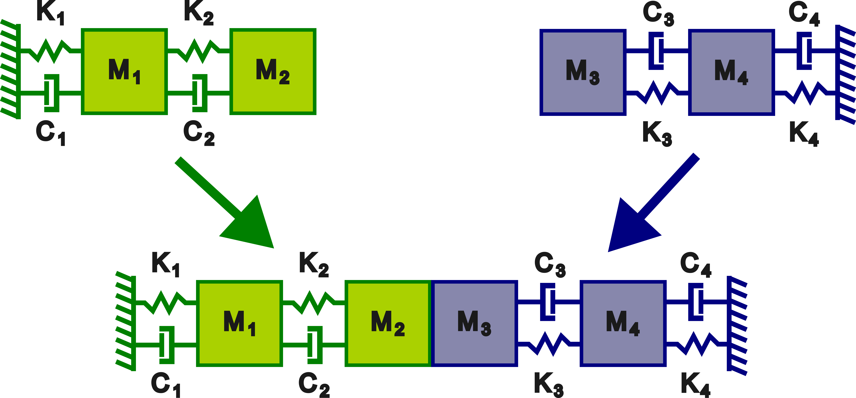
Example System for FBS Derivation

Slide 4
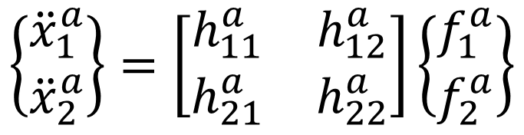
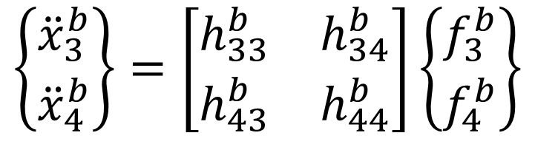
Example System for FBS Derivation
System A
System B
$$\left\{\begin{matrix}{\ddot{x}}_{1}^{a} \\ {\ddot{x}}_{2}^{a}\end{matrix}\right\}=\left[\begin{matrix}h_{11}^{a} & h_{12}^{a} \\ h_{21}^{a} & h_{22}^{a}\end{matrix}\right]\left\{\begin{matrix}f_{1}^{a} \\ f_{2}^{a}\end{matrix}\right\}$$
$$\left\{\begin{matrix}{\ddot{x}}_{3}^{b} \\ {\ddot{x}}_{4}^{b}\end{matrix}\right\}=\left[\begin{matrix}h_{33}^{b} & h_{34}^{b} \\ h_{43}^{b} & h_{44}^{b}\end{matrix}\right]\left\{\begin{matrix}f_{3}^{b} \\ f_{4}^{b}\end{matrix}\right\}$$

Slide 5
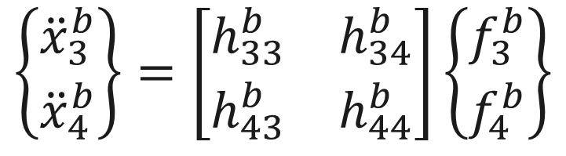
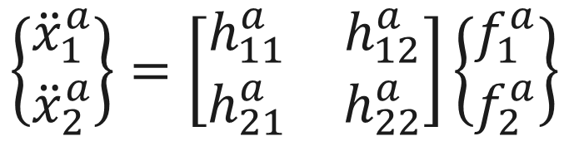
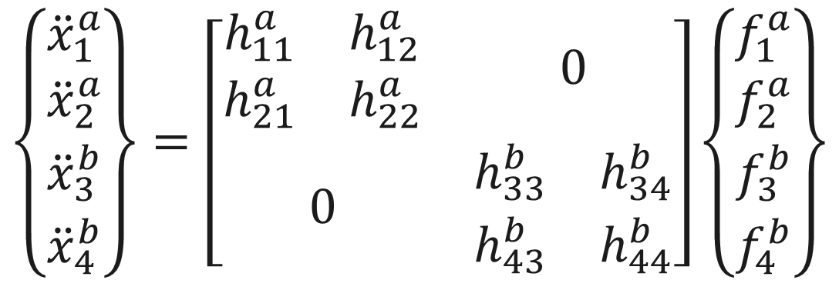
Assemble the FRFs in Block Diagonal Format
$$\left\{\begin{matrix}{\ddot{x}}_{1}^{a} \\ {\ddot{x}}_{2}^{a}\end{matrix}\right\}=\left[\begin{matrix}h_{11}^{a} & h_{12}^{a} \\ h_{21}^{a} & h_{22}^{a}\end{matrix}\right]\left\{\begin{matrix}f_{1}^{a} \\ f_{2}^{a}\end{matrix}\right\}$$
$$\left\{\begin{matrix}{\ddot{x}}_{3}^{b} \\ {\ddot{x}}_{4}^{b}\end{matrix}\right\}=\left[\begin{matrix}h_{33}^{b} & h_{34}^{b} \\ h_{43}^{b} & h_{44}^{b}\end{matrix}\right]\left\{\begin{matrix}f_{3}^{b} \\ f_{4}^{b}\end{matrix}\right\}$$
$$\left\{\begin{matrix}\begin{matrix}{\ddot{x}}_{1}^{a} \\ {\ddot{x}}_{2}^{a}\end{matrix} \\ \begin{matrix}{\ddot{x}}_{3}^{b} \\ {\ddot{x}}_{4}^{b}\end{matrix}\end{matrix}\right\}=\left[\begin{matrix}\begin{matrix}h_{11}^{a} & h_{12}^{a} \\ h_{21}^{a} & h_{22}^{a}\end{matrix} & 0 \\ 0 & \begin{matrix}h_{33}^{b} & h_{34}^{b} \\ h_{43}^{b} & h_{44}^{b}\end{matrix}\end{matrix}\right]\left\{\begin{matrix}\begin{matrix}f_{1}^{a} \\ f_{2}^{a}\end{matrix} \\ \begin{matrix}f_{3}^{b} \\ f_{4}^{b}\end{matrix}\end{matrix}\right\}$$

Slide 6
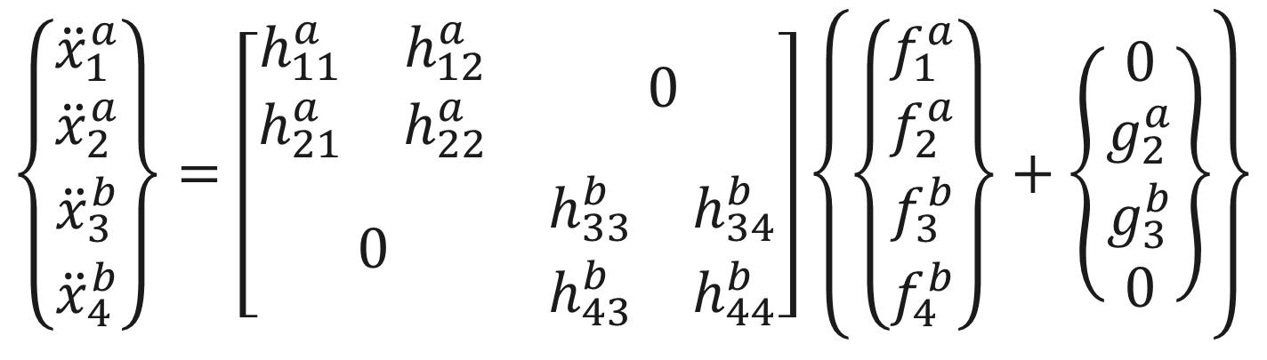
Add the Coupling Force at the Interface DOFs
$$\left\{\begin{matrix}{\ddot{x}}_{1}^{a} \\ {\ddot{x}}_{2}^{a}\end{matrix}\right\}=\left[\begin{matrix}h_{11}^{a} & h_{12}^{a} \\ h_{21}^{a} & h_{22}^{a}\end{matrix}\right]\left\{\begin{matrix}f_{1}^{a} \\ f_{2}^{a}\end{matrix}\right\}$$
$$\left\{\begin{matrix}{\ddot{x}}_{3}^{b} \\ {\ddot{x}}_{4}^{b}\end{matrix}\right\}=\left[\begin{matrix}h_{33}^{b} & h_{34}^{b} \\ h_{43}^{b} & h_{44}^{b}\end{matrix}\right]\left\{\begin{matrix}f_{3}^{b} \\ f_{4}^{b}\end{matrix}\right\}$$
$$\left\{\begin{matrix}\begin{matrix}{\ddot{x}}_{1}^{a} \\ {\ddot{x}}_{2}^{a}\end{matrix} \\ \begin{matrix}{\ddot{x}}_{3}^{b} \\ {\ddot{x}}_{4}^{b}\end{matrix}\end{matrix}\right\}=\left[\begin{matrix}\begin{matrix}h_{11}^{a} & h_{12}^{a} \\ h_{21}^{a} & h_{22}^{a}\end{matrix} & 0 \\ 0 & \begin{matrix}h_{33}^{b} & h_{34}^{b} \\ h_{43}^{b} & h_{44}^{b}\end{matrix}\end{matrix}\right]\left\{\left\{\begin{matrix}\begin{matrix}f_{1}^{a} \\ f_{2}^{a}\end{matrix} \\ \begin{matrix}f_{3}^{b} \\ f_{4}^{b}\end{matrix}\end{matrix}\right\}+\left\{\begin{matrix}\begin{matrix}0 \\ g_{2}^{a}\end{matrix} \\ \begin{matrix}g_{3}^{b} \\ 0\end{matrix}\end{matrix}\right\}\right\}$$
Coupling Force

Slide 7


Define the Compatibility Condition for the Forces
The FRFs are coupled by estimating coupling forces that satisfy interface compatibility and force equilibrium
$$\left\{\begin{matrix}\begin{matrix}{\ddot{x}}_{1}^{a} \\ {\ddot{x}}_{2}^{a}\end{matrix} \\ \begin{matrix}{\ddot{x}}_{3}^{b} \\ {\ddot{x}}_{4}^{b}\end{matrix}\end{matrix}\right\}=\left[\begin{matrix}\begin{matrix}h_{11}^{a} & h_{12}^{a} \\ h_{21}^{a} & h_{22}^{a}\end{matrix} & 0 \\ 0 & \begin{matrix}h_{33}^{b} & h_{34}^{b} \\ h_{43}^{b} & h_{44}^{b}\end{matrix}\end{matrix}\right]\left\{\left\{\begin{matrix}\begin{matrix}f_{1}^{a} \\ f_{2}^{a}\end{matrix} \\ \begin{matrix}f_{3}^{b} \\ f_{4}^{b}\end{matrix}\end{matrix}\right\}+\left\{\begin{matrix}\begin{matrix}0 \\ g_{2}^{a}\end{matrix} \\ \begin{matrix}g_{3}^{b} \\ 0\end{matrix}\end{matrix}\right\}\right\}$$
$${\ddot{x}}_{2}^{a}={\ddot{x}}_{3}^{b}$$
Interface Compatibility
$$g_{2}^{a}=−g_{3}^{b}$$
Force Equilibrium

Slide 8
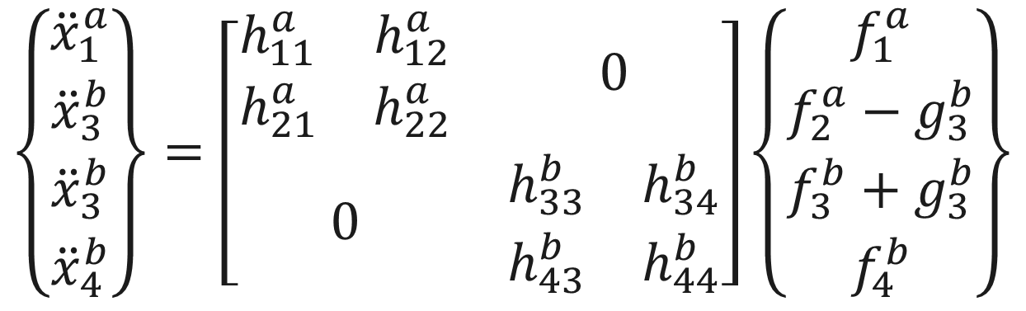
Apply the Compatibility Condition to the Equations
Applying the compatibility condition to the block diagonal FRFs makes it easy to see a path for estimating the coupling force
$$\left\{\begin{matrix}\begin{matrix}{\ddot{x}}_{1}^{a} \\ {\ddot{x}}_{3}^{b}\end{matrix} \\ \begin{matrix}{\ddot{x}}_{3}^{b} \\ {\ddot{x}}_{4}^{b}\end{matrix}\end{matrix}\right\}=\left[\begin{matrix}\begin{matrix}h_{11}^{a} & h_{12}^{a} \\ h_{21}^{a} & h_{22}^{a}\end{matrix} & 0 \\ 0 & \begin{matrix}h_{33}^{b} & h_{34}^{b} \\ h_{43}^{b} & h_{44}^{b}\end{matrix}\end{matrix}\right]\left\{\begin{matrix}\begin{matrix}f_{1}^{a} \\ f_{2}^{a}−g_{3}^{b}\end{matrix} \\ \begin{matrix}f_{3}^{b}+g_{3}^{b} \\ f_{4}^{b}\end{matrix}\end{matrix}\right\}$$

Slide 9
Basic FBS Derivation

Slide 10
FBS Derivation with Basic Linear Algebra
FBS can be derived with a basic understanding of:
Basic linear algebra
Newton’s second law
Frequency response functions
There are two forms of FBS
One-way – Computes FRFs with responses on one component and forces on another component
Two-way – Computes FRFs with responses and forces on all components
We’ll first show the derivation with basic math, then introduce LM-FBS

Slide 11
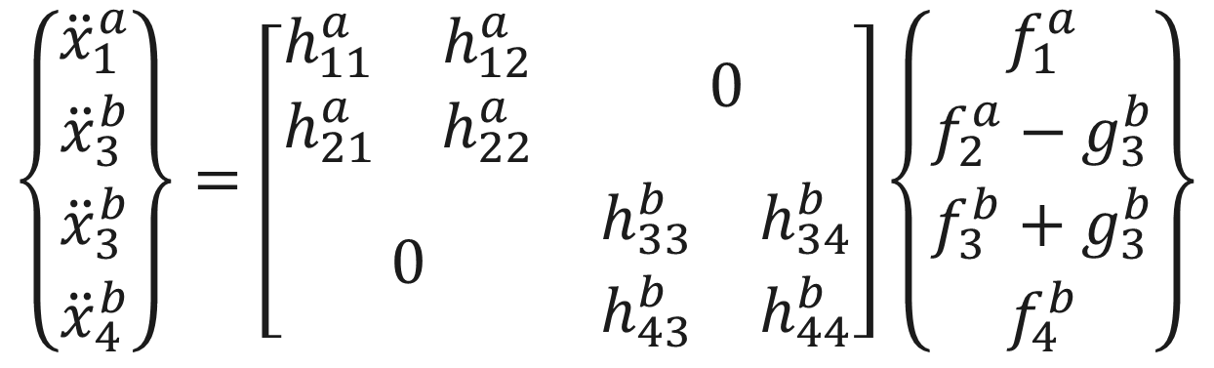
Solve the System of Equations to Find the Coupling Force
$$\left\{\begin{matrix}\begin{matrix}{\ddot{x}}_{1}^{a} \\ {\ddot{x}}_{3}^{b}\end{matrix} \\ \begin{matrix}{\ddot{x}}_{3}^{b} \\ {\ddot{x}}_{4}^{b}\end{matrix}\end{matrix}\right\}=\left[\begin{matrix}\begin{matrix}h_{11}^{a} & h_{12}^{a} \\ h_{21}^{a} & h_{22}^{a}\end{matrix} & 0 \\ 0 & \begin{matrix}h_{33}^{b} & h_{34}^{b} \\ h_{43}^{b} & h_{44}^{b}\end{matrix}\end{matrix}\right]\left\{\begin{matrix}\begin{matrix}f_{1}^{a} \\ f_{2}^{a}−g_{3}^{b}\end{matrix} \\ \begin{matrix}f_{3}^{b}+g_{3}^{b} \\ f_{4}^{b}\end{matrix}\end{matrix}\right\}$$
$${\ddot{x}}_{3}^{b}=h_{21}^{a}f_{1}^{a}+h_{22}^{a}f_{2}^{a}−h_{22}^{a}g_{3}^{b}=h_{33}^{b}f_{3}^{b}+h_{33}^{b}g_{3}^{b}+h_{34}^{b}f_{4}^{b}$$

Slide 12
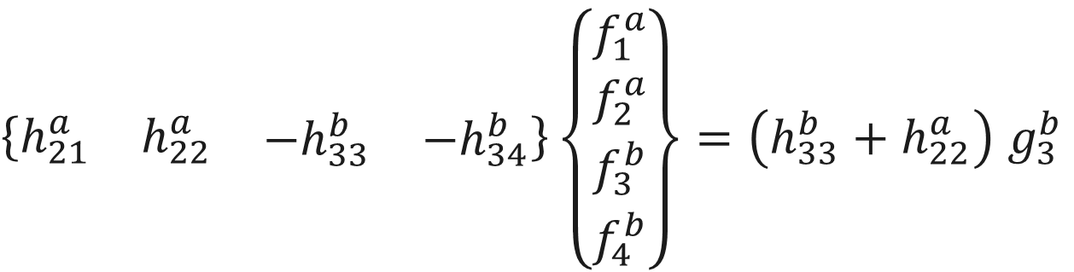
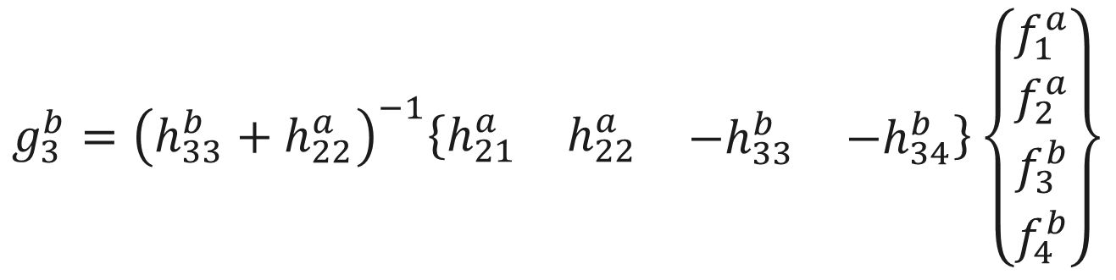
Solve the System of Equations to Find the Coupling Force
1.)
Gather external and coupling forces together
$$h_{21}^{a}f_{1}^{a}+h_{22}^{a}f_{2}^{a}−h_{33}^{b}f_{3}^{b}−h_{34}^{b}f_{4}^{b}=h_{33}^{b}g_{3}^{b}+h_{22}^{a}g_{3}^{b}$$
$\left\{\begin{matrix}\begin{matrix}h_{21}^{a} & h_{22}^{a}\end{matrix} & \begin{matrix}−h_{33}^{b} & −h_{34}^{b}\end{matrix}\end{matrix}\right\}\left\{\begin{matrix}\begin{matrix}f_{1}^{a} \\ f_{2}^{a}\end{matrix} \\ \begin{matrix}f_{3}^{b} \\ f_{4}^{b}\end{matrix}\end{matrix}\right\}=\left(h_{33}^{b}+h_{22}^{a}\right)$ $g_{3}^{b}$
2.)
Convert back to matrix notation
$$g_{3}^{b}={\left(h_{33}^{b}+h_{22}^{a}\right)}^{−1}\left\{\begin{matrix}\begin{matrix}h_{21}^{a} & h_{22}^{a}\end{matrix} & \begin{matrix}−h_{33}^{b} & −h_{34}^{b}\end{matrix}\end{matrix}\right\}\left\{\begin{matrix}\begin{matrix}f_{1}^{a} \\ f_{2}^{a}\end{matrix} \\ \begin{matrix}f_{3}^{b} \\ f_{4}^{b}\end{matrix}\end{matrix}\right\}$$
3.)
Solve for the coupling force
The coupling force is all we need to solve the substructuring problem

Slide 13
One-way FBS

Slide 14




Deriving One-way FBS
One-way FBS is only concerned with responses on system B due to forces on system A and is particularly useful in TPA
System A
System B
$$f_{1}^{a}$$
$$f_{2}^{a}$$
$${\ddot{x}}_{3}^{b}$$
$${\ddot{x}}_{4}^{b}$$

Slide 15
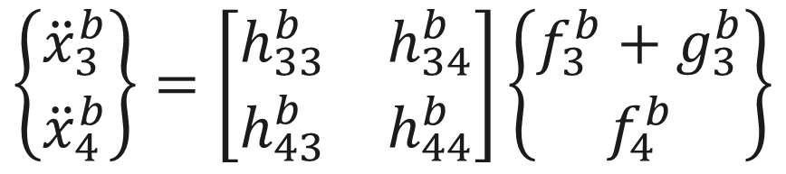
Deriving One-way FBS
One-way FBS is only concerned with responses on system B due to forces on system A and is particularly useful in TPA
System A
System B
$$\left\{\begin{matrix}{\ddot{x}}_{3}^{b} \\ {\ddot{x}}_{4}^{b}\end{matrix}\right\}=\left[\begin{matrix}h_{33}^{b} & h_{34}^{b} \\ h_{43}^{b} & h_{44}^{b}\end{matrix}\right]\left\{\begin{matrix}f_{3}^{b}+g_{3}^{b} \\ f_{4}^{b}\end{matrix}\right\}$$

Slide 16
Deriving One-way FBS
One-way FBS is only concerned with responses on system B due to forces on system A and is particularly useful in TPA
System A
System B
$$\left\{\begin{matrix}{\ddot{x}}_{3}^{b} \\ {\ddot{x}}_{4}^{b}\end{matrix}\right\}=\left[\begin{matrix}h_{33}^{b} & h_{34}^{b} \\ h_{43}^{b} & h_{44}^{b}\end{matrix}\right]\left\{\begin{matrix}f_{3}^{b}+g_{3}^{b} \\ f_{4}^{b}\end{matrix}\right\}$$

Slide 17
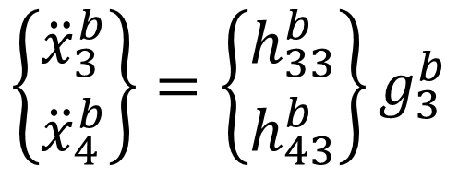
Deriving One-way FBS
One-way FBS is only concerned with responses on system B due to forces on system A and is particularly useful in TPA
System A
System B
$$\left\{\begin{matrix}{\ddot{x}}_{3}^{b} \\ {\ddot{x}}_{4}^{b}\end{matrix}\right\}=\left\{\begin{matrix}h_{33}^{b} \\ h_{43}^{b}\end{matrix}\right\}g_{3}^{b}$$

Slide 18
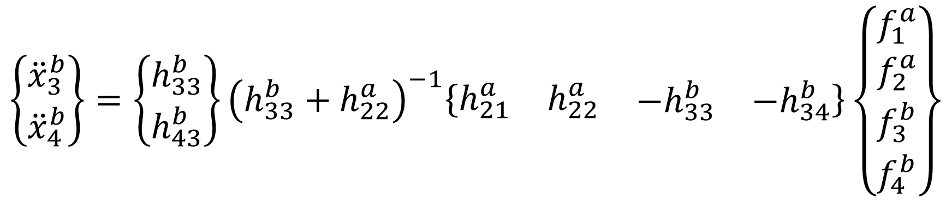
Deriving One-way FBS
One-way FBS is only concerned with responses on system B due to forces on system A and is particularly useful in TPA
System A
System B
$$\left\{\begin{matrix}{\ddot{x}}_{3}^{b} \\ {\ddot{x}}_{4}^{b}\end{matrix}\right\}=\left\{\begin{matrix}h_{33}^{b} \\ h_{43}^{b}\end{matrix}\right\}{\left(h_{33}^{b}+h_{22}^{a}\right)}^{−1}\left\{\begin{matrix}\begin{matrix}h_{21}^{a} & h_{22}^{a}\end{matrix} & \begin{matrix}−h_{33}^{b} & −h_{34}^{b}\end{matrix}\end{matrix}\right\}\left\{\begin{matrix}\begin{matrix}f_{1}^{a} \\ f_{2}^{a}\end{matrix} \\ \begin{matrix}f_{3}^{b} \\ f_{4}^{b}\end{matrix}\end{matrix}\right\}$$

Slide 19
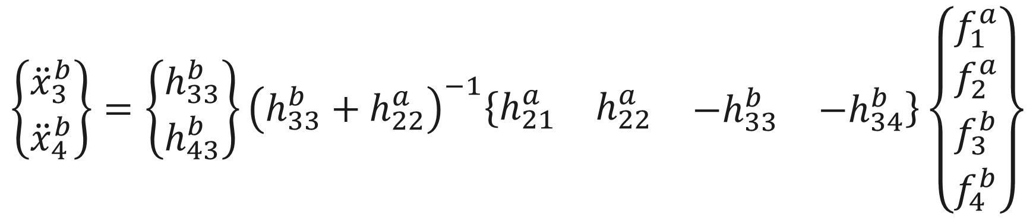
Deriving One-way FBS
One-way FBS is only concerned with responses on system B due to forces on system A and is particularly useful in TPA
System A
System B
$$\left\{\begin{matrix}{\ddot{x}}_{3}^{b} \\ {\ddot{x}}_{4}^{b}\end{matrix}\right\}=\left\{\begin{matrix}h_{33}^{b} \\ h_{43}^{b}\end{matrix}\right\}{\left(h_{33}^{b}+h_{22}^{a}\right)}^{−1}\left\{\begin{matrix}\begin{matrix}h_{21}^{a} & h_{22}^{a}\end{matrix} & \begin{matrix}−h_{33}^{b} & −h_{34}^{b}\end{matrix}\end{matrix}\right\}\left\{\begin{matrix}\begin{matrix}f_{1}^{a} \\ f_{2}^{a}\end{matrix} \\ \begin{matrix}f_{3}^{b} \\ f_{4}^{b}\end{matrix}\end{matrix}\right\}$$

Slide 20
Deriving One-way FBS
One-way FBS is only concerned with responses on system B due to forces on system A and is particularly useful in TPA
System A
System B
$$\left\{\begin{matrix}{\ddot{x}}_{3}^{b} \\ {\ddot{x}}_{4}^{b}\end{matrix}\right\}=\left\{\begin{matrix}h_{33}^{b} \\ h_{43}^{b}\end{matrix}\right\}{\left(h_{33}^{b}+h_{22}^{a}\right)}^{−1}\left\{\begin{matrix}\begin{matrix}h_{21}^{a} & h_{22}^{a}\end{matrix} & \begin{matrix}−h_{33}^{b} & −h_{34}^{b}\end{matrix}\end{matrix}\right\}\left\{\begin{matrix}\begin{matrix}f_{1}^{a} \\ f_{2}^{a}\end{matrix} \\ \begin{matrix}f_{3}^{b} \\ f_{4}^{b}\end{matrix}\end{matrix}\right\}$$

Slide 21
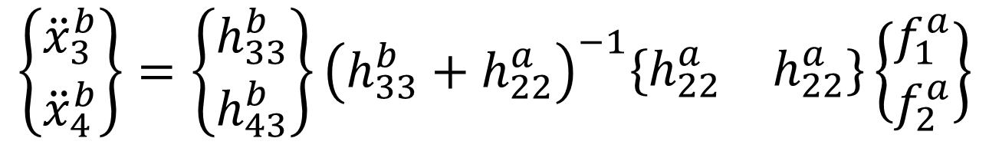
Deriving One-way FBS
One-way FBS is only concerned with responses on system B due to forces on system A and is particularly useful in TPA
System A
System B
$$\left\{\begin{matrix}{\ddot{x}}_{3}^{b} \\ {\ddot{x}}_{4}^{b}\end{matrix}\right\}=\left\{\begin{matrix}h_{33}^{b} \\ h_{43}^{b}\end{matrix}\right\}{\left(h_{33}^{b}+h_{22}^{a}\right)}^{−1}\left\{\begin{matrix}h_{22}^{a} & h_{22}^{a}\end{matrix}\right\}\left\{\begin{matrix}f_{1}^{a} \\ f_{2}^{a}\end{matrix}\right\}$$

Slide 22
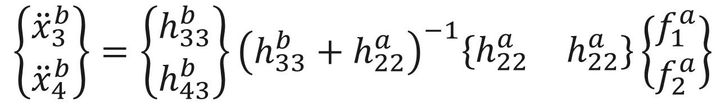
Deriving One-way FBS
One-way FBS is only concerned with responses on system B due to forces on system A and is particularly useful in TPA
System A
System B
$$\left\{\begin{matrix}{\ddot{x}}_{3}^{b} \\ {\ddot{x}}_{4}^{b}\end{matrix}\right\}=\left\{\begin{matrix}h_{33}^{b} \\ h_{43}^{b}\end{matrix}\right\}{\left(h_{33}^{b}+h_{22}^{a}\right)}^{−1}\left\{\begin{matrix}h_{22}^{a} & h_{22}^{a}\end{matrix}\right\}\left\{\begin{matrix}f_{1}^{a} \\ f_{2}^{a}\end{matrix}\right\}$$
Coupled FRF Matrix

Slide 23
Two-way FBS

Slide 24








Deriving Two-way FBS
Two-way FBS is the full substructuring problem and computes FRFs between all the DOFs in the coupled system
System A
System B
$${\ddot{x}}_{1}^{a}$$
$${\ddot{x}}_{2}^{a}$$
$${\ddot{x}}_{3}^{b}$$
$${\ddot{x}}_{4}^{b}$$
$$f_{1}^{a}$$
$$f_{2}^{a}$$
$$f_{3}^{b}$$
$$f_{4}^{b}$$

Slide 25
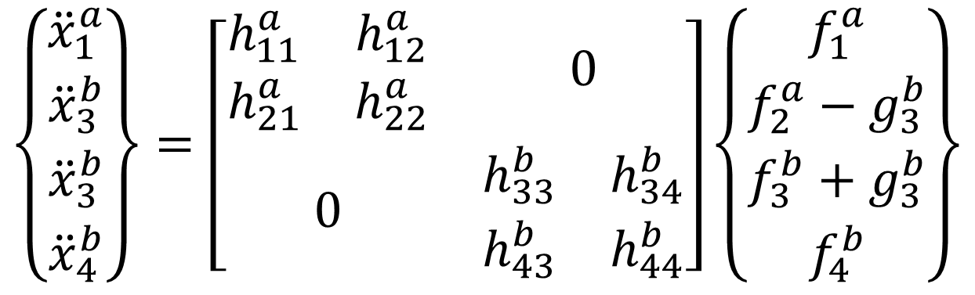
Deriving Two-way FBS
Two-way FBS is the full substructuring problem and computes FRFs between all the DOFs in the coupled system
System A
System B
$$\left\{\begin{matrix}\begin{matrix}{\ddot{x}}_{1}^{a} \\ {\ddot{x}}_{3}^{b}\end{matrix} \\ \begin{matrix}{\ddot{x}}_{3}^{b} \\ {\ddot{x}}_{4}^{b}\end{matrix}\end{matrix}\right\}=\left[\begin{matrix}\begin{matrix}h_{11}^{a} & h_{12}^{a} \\ h_{21}^{a} & h_{22}^{a}\end{matrix} & 0 \\ 0 & \begin{matrix}h_{33}^{b} & h_{34}^{b} \\ h_{43}^{b} & h_{44}^{b}\end{matrix}\end{matrix}\right]\left\{\begin{matrix}\begin{matrix}f_{1}^{a} \\ f_{2}^{a}−g_{3}^{b}\end{matrix} \\ \begin{matrix}f_{3}^{b}+g_{3}^{b} \\ f_{4}^{b}\end{matrix}\end{matrix}\right\}$$

Slide 26
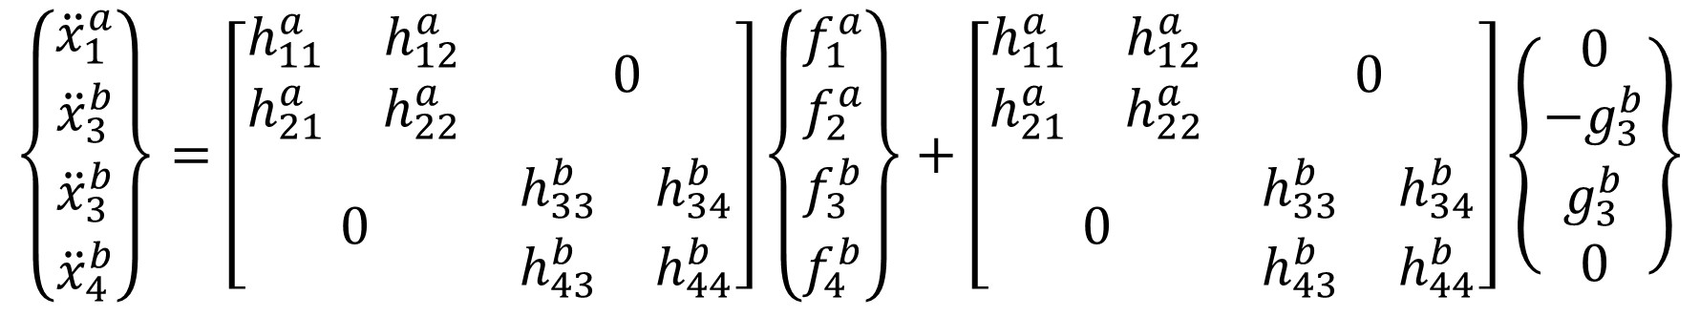
Deriving Two-way FBS
Two-way FBS is the full substructuring problem and computes FRFs between all the DOFs in the coupled system
System A
System B
$$\left\{\begin{matrix}\begin{matrix}{\ddot{x}}_{1}^{a} \\ {\ddot{x}}_{3}^{b}\end{matrix} \\ \begin{matrix}{\ddot{x}}_{3}^{b} \\ {\ddot{x}}_{4}^{b}\end{matrix}\end{matrix}\right\}=\left[\begin{matrix}\begin{matrix}h_{11}^{a} & h_{12}^{a} \\ h_{21}^{a} & h_{22}^{a}\end{matrix} & 0 \\ 0 & \begin{matrix}h_{33}^{b} & h_{34}^{b} \\ h_{43}^{b} & h_{44}^{b}\end{matrix}\end{matrix}\right]\left\{\begin{matrix}\begin{matrix}f_{1}^{a} \\ f_{2}^{a}\end{matrix} \\ \begin{matrix}f_{3}^{b} \\ f_{4}^{b}\end{matrix}\end{matrix}\right\}+\left[\begin{matrix}\begin{matrix}h_{11}^{a} & h_{12}^{a} \\ h_{21}^{a} & h_{22}^{a}\end{matrix} & 0 \\ 0 & \begin{matrix}h_{33}^{b} & h_{34}^{b} \\ h_{43}^{b} & h_{44}^{b}\end{matrix}\end{matrix}\right]\left\{\begin{matrix}\begin{matrix}0 \\ −g_{3}^{b}\end{matrix} \\ \begin{matrix}g_{3}^{b} \\ 0\end{matrix}\end{matrix}\right\}$$

Slide 27
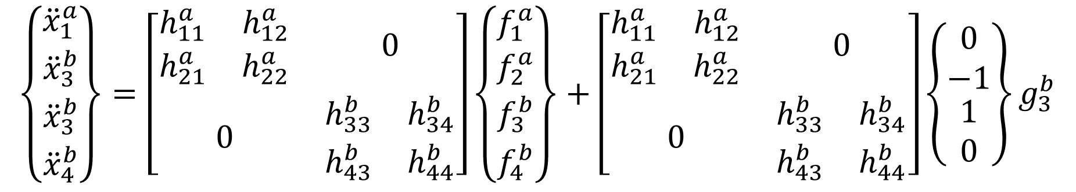
Deriving Two-way FBS
Two-way FBS is the full substructuring problem and computes FRFs between all the DOFs in the coupled system
System A
System B
$$\left\{\begin{matrix}\begin{matrix}{\ddot{x}}_{1}^{a} \\ {\ddot{x}}_{3}^{b}\end{matrix} \\ \begin{matrix}{\ddot{x}}_{3}^{b} \\ {\ddot{x}}_{4}^{b}\end{matrix}\end{matrix}\right\}=\left[\begin{matrix}\begin{matrix}h_{11}^{a} & h_{12}^{a} \\ h_{21}^{a} & h_{22}^{a}\end{matrix} & 0 \\ 0 & \begin{matrix}h_{33}^{b} & h_{34}^{b} \\ h_{43}^{b} & h_{44}^{b}\end{matrix}\end{matrix}\right]\left\{\begin{matrix}\begin{matrix}f_{1}^{a} \\ f_{2}^{a}\end{matrix} \\ \begin{matrix}f_{3}^{b} \\ f_{4}^{b}\end{matrix}\end{matrix}\right\}+\left[\begin{matrix}\begin{matrix}h_{11}^{a} & h_{12}^{a} \\ h_{21}^{a} & h_{22}^{a}\end{matrix} & 0 \\ 0 & \begin{matrix}h_{33}^{b} & h_{34}^{b} \\ h_{43}^{b} & h_{44}^{b}\end{matrix}\end{matrix}\right]\left\{\begin{matrix}\begin{matrix}0 \\ −1\end{matrix} \\ \begin{matrix}1 \\ 0\end{matrix}\end{matrix}\right\}g_{3}^{b}$$

Slide 28
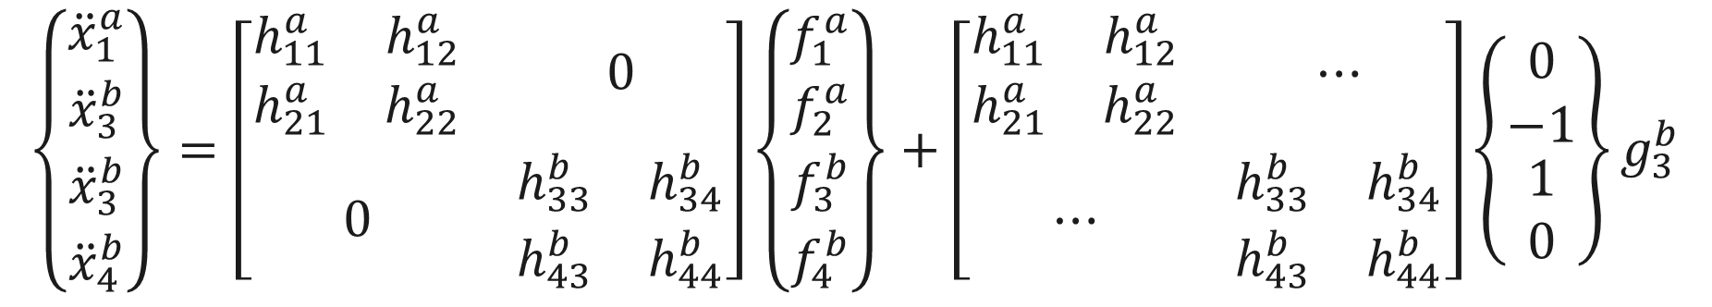
Deriving Two-way FBS
Two-way FBS is the full substructuring problem and computes FRFs between all the DOFs in the coupled system
System A
System B
Multiply
$$\left\{\begin{matrix}\begin{matrix}{\ddot{x}}_{1}^{a} \\ {\ddot{x}}_{3}^{b}\end{matrix} \\ \begin{matrix}{\ddot{x}}_{3}^{b} \\ {\ddot{x}}_{4}^{b}\end{matrix}\end{matrix}\right\}=\left[\begin{matrix}\begin{matrix}h_{11}^{a} & h_{12}^{a} \\ h_{21}^{a} & h_{22}^{a}\end{matrix} & 0 \\ 0 & \begin{matrix}h_{33}^{b} & h_{34}^{b} \\ h_{43}^{b} & h_{44}^{b}\end{matrix}\end{matrix}\right]\left\{\begin{matrix}\begin{matrix}f_{1}^{a} \\ f_{2}^{a}\end{matrix} \\ \begin{matrix}f_{3}^{b} \\ f_{4}^{b}\end{matrix}\end{matrix}\right\}+\left[\begin{matrix}\begin{matrix}h_{11}^{a} & h_{12}^{a} \\ h_{21}^{a} & h_{22}^{a}\end{matrix} & ⋯ \\ ⋯ & \begin{matrix}h_{33}^{b} & h_{34}^{b} \\ h_{43}^{b} & h_{44}^{b}\end{matrix}\end{matrix}\right]\left\{\begin{matrix}\begin{matrix}0 \\ −1\end{matrix} \\ \begin{matrix}1 \\ 0\end{matrix}\end{matrix}\right\}g_{3}^{b}$$

Slide 29
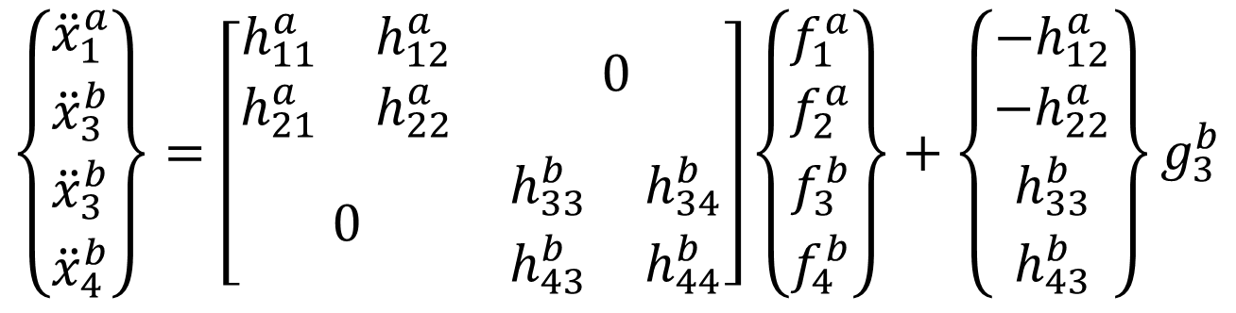
Deriving Two-way FBS
Two-way FBS is the full substructuring problem and computes FRFs between all the DOFs in the coupled system
System A
System B
$$\left\{\begin{matrix}\begin{matrix}{\ddot{x}}_{1}^{a} \\ {\ddot{x}}_{3}^{b}\end{matrix} \\ \begin{matrix}{\ddot{x}}_{3}^{b} \\ {\ddot{x}}_{4}^{b}\end{matrix}\end{matrix}\right\}=\left[\begin{matrix}\begin{matrix}h_{11}^{a} & h_{12}^{a} \\ h_{21}^{a} & h_{22}^{a}\end{matrix} & 0 \\ 0 & \begin{matrix}h_{33}^{b} & h_{34}^{b} \\ h_{43}^{b} & h_{44}^{b}\end{matrix}\end{matrix}\right]\left\{\begin{matrix}\begin{matrix}f_{1}^{a} \\ f_{2}^{a}\end{matrix} \\ \begin{matrix}f_{3}^{b} \\ f_{4}^{b}\end{matrix}\end{matrix}\right\}+\left\{\begin{matrix}\begin{matrix}−h_{12}^{a} \\ −h_{22}^{a}\end{matrix} \\ \begin{matrix}h_{33}^{b} \\ h_{43}^{b}\end{matrix}\end{matrix}\right\}g_{3}^{b}$$

Slide 30
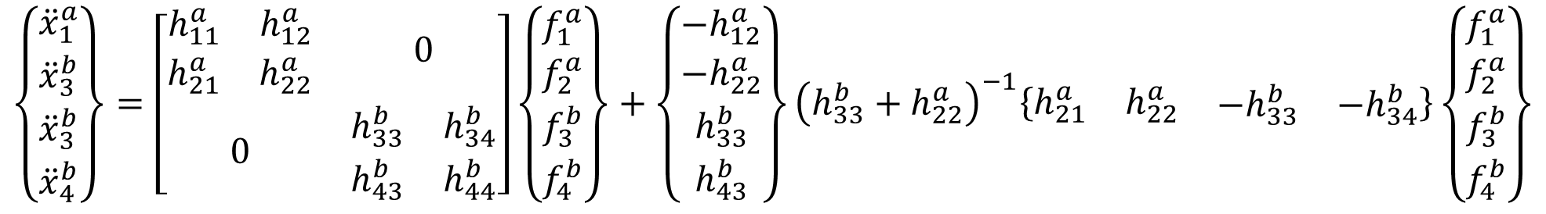
Deriving Two-way FBS
Two-way FBS is the full substructuring problem and computes FRFs between all the DOFs in the coupled system
System A
System B
$$\left\{\begin{matrix}\begin{matrix}{\ddot{x}}_{1}^{a} \\ {\ddot{x}}_{3}^{b}\end{matrix} \\ \begin{matrix}{\ddot{x}}_{3}^{b} \\ {\ddot{x}}_{4}^{b}\end{matrix}\end{matrix}\right\}=\left[\begin{matrix}\begin{matrix}h_{11}^{a} & h_{12}^{a} \\ h_{21}^{a} & h_{22}^{a}\end{matrix} & 0 \\ 0 & \begin{matrix}h_{33}^{b} & h_{34}^{b} \\ h_{43}^{b} & h_{44}^{b}\end{matrix}\end{matrix}\right]\left\{\begin{matrix}\begin{matrix}f_{1}^{a} \\ f_{2}^{a}\end{matrix} \\ \begin{matrix}f_{3}^{b} \\ f_{4}^{b}\end{matrix}\end{matrix}\right\}+\left\{\begin{matrix}\begin{matrix}−h_{12}^{a} \\ −h_{22}^{a}\end{matrix} \\ \begin{matrix}h_{33}^{b} \\ h_{43}^{b}\end{matrix}\end{matrix}\right\}{\left(h_{33}^{b}+h_{22}^{a}\right)}^{−1}\left\{\begin{matrix}\begin{matrix}h_{21}^{a} & h_{22}^{a}\end{matrix} & \begin{matrix}−h_{33}^{b} & −h_{34}^{b}\end{matrix}\end{matrix}\right\}\left\{\begin{matrix}\begin{matrix}f_{1}^{a} \\ f_{2}^{a}\end{matrix} \\ \begin{matrix}f_{3}^{b} \\ f_{4}^{b}\end{matrix}\end{matrix}\right\}$$

Slide 31
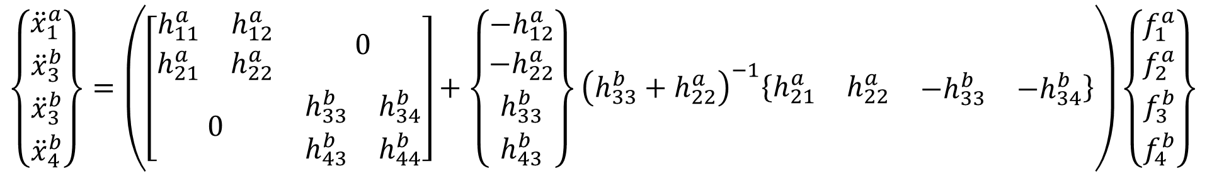
Deriving Two-way FBS
Two-way FBS is the full substructuring problem and computes FRFs between all the DOFs in the coupled system
System A
System B
$$\left\{\begin{matrix}\begin{matrix}{\ddot{x}}_{1}^{a} \\ {\ddot{x}}_{3}^{b}\end{matrix} \\ \begin{matrix}{\ddot{x}}_{3}^{b} \\ {\ddot{x}}_{4}^{b}\end{matrix}\end{matrix}\right\}=\left(\left[\begin{matrix}\begin{matrix}h_{11}^{a} & h_{12}^{a} \\ h_{21}^{a} & h_{22}^{a}\end{matrix} & 0 \\ 0 & \begin{matrix}h_{33}^{b} & h_{34}^{b} \\ h_{43}^{b} & h_{44}^{b}\end{matrix}\end{matrix}\right]+\left\{\begin{matrix}\begin{matrix}−h_{12}^{a} \\ −h_{22}^{a}\end{matrix} \\ \begin{matrix}h_{33}^{b} \\ h_{43}^{b}\end{matrix}\end{matrix}\right\}{\left(h_{33}^{b}+h_{22}^{a}\right)}^{−1}\left\{\begin{matrix}\begin{matrix}h_{21}^{a} & h_{22}^{a}\end{matrix} & \begin{matrix}−h_{33}^{b} & −h_{34}^{b}\end{matrix}\end{matrix}\right\}\right)\left\{\begin{matrix}\begin{matrix}f_{1}^{a} \\ f_{2}^{a}\end{matrix} \\ \begin{matrix}f_{3}^{b} \\ f_{4}^{b}\end{matrix}\end{matrix}\right\}$$

Slide 32
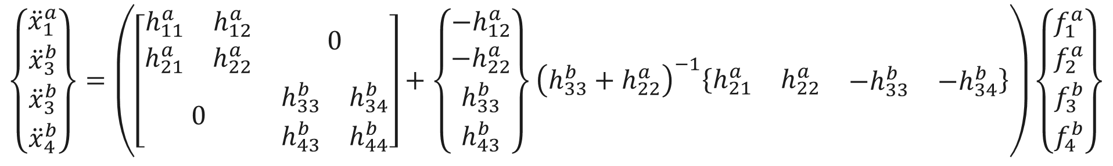
Deriving Two-way FBS
Two-way FBS is the full substructuring problem and computes FRFs between all the DOFs in the coupled system
System A
System B
$$\left\{\begin{matrix}\begin{matrix}{\ddot{x}}_{1}^{a} \\ {\ddot{x}}_{3}^{b}\end{matrix} \\ \begin{matrix}{\ddot{x}}_{3}^{b} \\ {\ddot{x}}_{4}^{b}\end{matrix}\end{matrix}\right\}=\left(\left[\begin{matrix}\begin{matrix}h_{11}^{a} & h_{12}^{a} \\ h_{21}^{a} & h_{22}^{a}\end{matrix} & 0 \\ 0 & \begin{matrix}h_{33}^{b} & h_{34}^{b} \\ h_{43}^{b} & h_{44}^{b}\end{matrix}\end{matrix}\right]+\left\{\begin{matrix}\begin{matrix}−h_{12}^{a} \\ −h_{22}^{a}\end{matrix} \\ \begin{matrix}h_{33}^{b} \\ h_{43}^{b}\end{matrix}\end{matrix}\right\}{\left(h_{33}^{b}+h_{22}^{a}\right)}^{−1}\left\{\begin{matrix}\begin{matrix}h_{21}^{a} & h_{22}^{a}\end{matrix} & \begin{matrix}−h_{33}^{b} & −h_{34}^{b}\end{matrix}\end{matrix}\right\}\right)\left\{\begin{matrix}\begin{matrix}f_{1}^{a} \\ f_{2}^{a}\end{matrix} \\ \begin{matrix}f_{3}^{b} \\ f_{4}^{b}\end{matrix}\end{matrix}\right\}$$
Coupled FRF Matrix

Slide 33
Summarizing the FBS Process

Slide 34
FBS Process Summary
Define constraints for interface compatibility and force equilibrium
Responses at coupling DOFs must be the same
Forces at coupling DOFs must be equal and opposite
Apply the constraints to the block diagonal FRF equation of motion
Solve for the coupling force – some of the literature makes the math look really fancy, but it can be done with simple algebra
Apply the coupling force to the original FRF based equation of motion

Slide 35
FBS Process Summary
Define constraints for interface compatibility and force equilibrium
Responses at coupling DOFs must be the same
Forces at coupling DOFs must be equal and opposite
Apply the constraints to the block diagonal FRF equation of motion
Solve for the coupling force – some of the literature makes the math look really fancy, but it can be done with simple algebra
Apply the coupling force to the original FRF based equation of motion

Slide 36
FBS Process Summary
Define constraints for interface compatibility and force equilibrium
Responses at coupling DOFs must be the same
Forces at coupling DOFs must be equal and opposite
Apply the constraints to the block diagonal FRF equation of motion
Solve for the coupling force – some of the literature makes the math look really fancy, but it can be done with simple algebra
Apply the coupling force to the original FRF based equation of motion

Slide 37
FBS Process Summary
Define constraints for interface compatibility and force equilibrium
Responses at coupling DOFs must be the same
Forces at coupling DOFs must be equal and opposite
Apply the constraints to the block diagonal FRF equation of motion
Solve for the coupling force – some of the literature makes the math look really fancy, but it can be done with simple algebra
Apply the coupling force to the original FRF based equation of motion

Slide 38
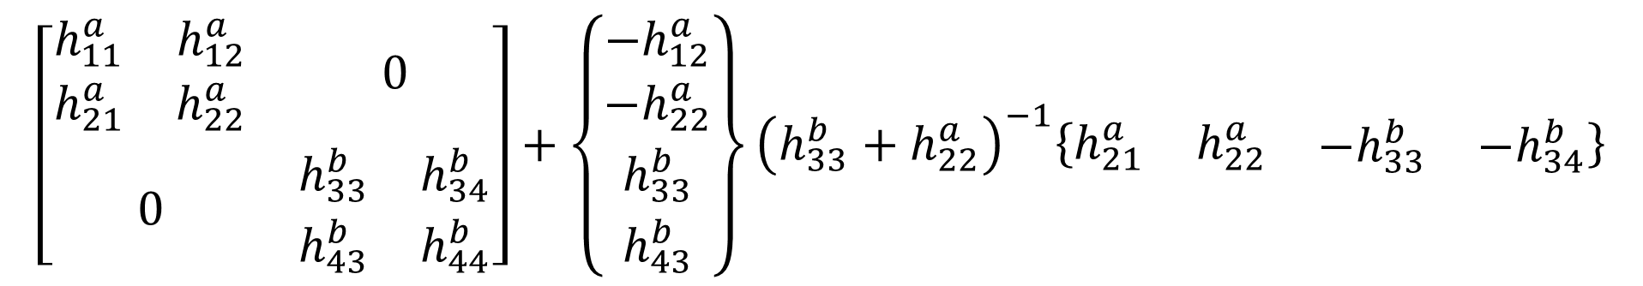
A Closer Look at the Equation
$$\left[\begin{matrix}\begin{matrix}h_{11}^{a} & h_{12}^{a} \\ h_{21}^{a} & h_{22}^{a}\end{matrix} & 0 \\ 0 & \begin{matrix}h_{33}^{b} & h_{34}^{b} \\ h_{43}^{b} & h_{44}^{b}\end{matrix}\end{matrix}\right]+\left\{\begin{matrix}\begin{matrix}−h_{12}^{a} \\ −h_{22}^{a}\end{matrix} \\ \begin{matrix}h_{33}^{b} \\ h_{43}^{b}\end{matrix}\end{matrix}\right\}{\left(h_{33}^{b}+h_{22}^{a}\right)}^{−1}\left\{\begin{matrix}\begin{matrix}h_{21}^{a} & h_{22}^{a}\end{matrix} & \begin{matrix}−h_{33}^{b} & −h_{34}^{b}\end{matrix}\end{matrix}\right\}$$
The equation has a pattern, with distinct information in the different vector/matrix quantities
The coupling forces are estimated via an inverse problem, which requires special attention
FBS results in duplicate response/reference DOFs at the coupling, since the method doesn’t reshape the FRF matrix

Slide 39
A Closer Look at the Equation
Block Diagonal FRF Matrix
$$\left[\begin{matrix}\begin{matrix}h_{11}^{a} & h_{12}^{a} \\ h_{21}^{a} & h_{22}^{a}\end{matrix} & 0 \\ 0 & \begin{matrix}h_{33}^{b} & h_{34}^{b} \\ h_{43}^{b} & h_{44}^{b}\end{matrix}\end{matrix}\right]+\left\{\begin{matrix}\begin{matrix}−h_{12}^{a} \\ −h_{22}^{a}\end{matrix} \\ \begin{matrix}h_{33}^{b} \\ h_{43}^{b}\end{matrix}\end{matrix}\right\}{\left(h_{33}^{b}+h_{22}^{a}\right)}^{−1}\left\{\begin{matrix}\begin{matrix}h_{21}^{a} & h_{22}^{a}\end{matrix} & \begin{matrix}−h_{33}^{b} & −h_{34}^{b}\end{matrix}\end{matrix}\right\}$$
The equation has a pattern, with distinct information in the different vector/matrix quantities
The coupling forces are estimated via an inverse problem, which requires special attention
FBS results in duplicate response/reference DOFs at the coupling, since the method doesn’t reshape the FRF matrix

Slide 40
A Closer Look at the Equation
Block Diagonal FRF Matrix
Response/Coupling FRFs
$$\left[\begin{matrix}\begin{matrix}h_{11}^{a} & h_{12}^{a} \\ h_{21}^{a} & h_{22}^{a}\end{matrix} & 0 \\ 0 & \begin{matrix}h_{33}^{b} & h_{34}^{b} \\ h_{43}^{b} & h_{44}^{b}\end{matrix}\end{matrix}\right]+\left\{\begin{matrix}\begin{matrix}−h_{12}^{a} \\ −h_{22}^{a}\end{matrix} \\ \begin{matrix}h_{33}^{b} \\ h_{43}^{b}\end{matrix}\end{matrix}\right\}{\left(h_{33}^{b}+h_{22}^{a}\right)}^{−1}\left\{\begin{matrix}\begin{matrix}h_{21}^{a} & h_{22}^{a}\end{matrix} & \begin{matrix}−h_{33}^{b} & −h_{34}^{b}\end{matrix}\end{matrix}\right\}$$
The equation has a pattern, with distinct information in the different vector/matrix quantities
The coupling forces are estimated via an inverse problem, which requires special attention
FBS results in duplicate response/reference DOFs at the coupling, since the method doesn’t reshape the FRF matrix

Slide 41
A Closer Look at the Equation
Block Diagonal FRF Matrix
Response/Coupling FRFs
$$\left[\begin{matrix}\begin{matrix}h_{11}^{a} & h_{12}^{a} \\ h_{21}^{a} & h_{22}^{a}\end{matrix} & 0 \\ 0 & \begin{matrix}h_{33}^{b} & h_{34}^{b} \\ h_{43}^{b} & h_{44}^{b}\end{matrix}\end{matrix}\right]+\left\{\begin{matrix}\begin{matrix}−h_{12}^{a} \\ −h_{22}^{a}\end{matrix} \\ \begin{matrix}h_{33}^{b} \\ h_{43}^{b}\end{matrix}\end{matrix}\right\}{\left(h_{33}^{b}+h_{22}^{a}\right)}^{−1}\left\{\begin{matrix}\begin{matrix}h_{21}^{a} & h_{22}^{a}\end{matrix} & \begin{matrix}−h_{33}^{b} & −h_{34}^{b}\end{matrix}\end{matrix}\right\}$$
Coupling/Coupling FRFs
The equation has a pattern, with distinct information in the different vector/matrix quantities
The coupling forces are estimated via an inverse problem, which requires special attention
FBS results in duplicate response/reference DOFs at the coupling, since the method doesn’t reshape the FRF matrix

Slide 42
A Closer Look at the Equation
Block Diagonal FRF Matrix
Response/Coupling FRFs
$$\left[\begin{matrix}\begin{matrix}h_{11}^{a} & h_{12}^{a} \\ h_{21}^{a} & h_{22}^{a}\end{matrix} & 0 \\ 0 & \begin{matrix}h_{33}^{b} & h_{34}^{b} \\ h_{43}^{b} & h_{44}^{b}\end{matrix}\end{matrix}\right]+\left\{\begin{matrix}\begin{matrix}−h_{12}^{a} \\ −h_{22}^{a}\end{matrix} \\ \begin{matrix}h_{33}^{b} \\ h_{43}^{b}\end{matrix}\end{matrix}\right\}{\left(h_{33}^{b}+h_{22}^{a}\right)}^{−1}\left\{\begin{matrix}\begin{matrix}h_{21}^{a} & h_{22}^{a}\end{matrix} & \begin{matrix}−h_{33}^{b} & −h_{34}^{b}\end{matrix}\end{matrix}\right\}$$
Coupling/Coupling FRFs
Coupling/Force FRFs
The equation has a pattern, with distinct information in the different vector/matrix quantities
The coupling forces are estimated via an inverse problem, which requires special attention
FBS results in duplicate response/reference DOFs at the coupling, since the method doesn’t reshape the FRF matrix

Slide 43
A Closer Look at the Equation
Block Diagonal FRF Matrix
Response/Coupling FRFs
$$\left[\begin{matrix}\begin{matrix}h_{11}^{a} & h_{12}^{a} \\ h_{21}^{a} & h_{22}^{a}\end{matrix} & 0 \\ 0 & \begin{matrix}h_{33}^{b} & h_{34}^{b} \\ h_{43}^{b} & h_{44}^{b}\end{matrix}\end{matrix}\right]+\left\{\begin{matrix}\begin{matrix}−h_{12}^{a} \\ −h_{22}^{a}\end{matrix} \\ \begin{matrix}h_{33}^{b} \\ h_{43}^{b}\end{matrix}\end{matrix}\right\}{\left(h_{33}^{b}+h_{22}^{a}\right)}^{−1}\left\{\begin{matrix}\begin{matrix}h_{21}^{a} & h_{22}^{a}\end{matrix} & \begin{matrix}−h_{33}^{b} & −h_{34}^{b}\end{matrix}\end{matrix}\right\}$$
Coupling/Coupling FRFs
Coupling/Force FRFs
The equation has a pattern, with distinct information in the different vector/matrix quantities
The coupling forces are estimated via an inverse problem, which requires special attention
FBS results in duplicate response/reference DOFs at the coupling, since the method doesn’t reshape the FRF matrix

Slide 44
A Closer Look at the Equation
Block Diagonal FRF Matrix
Response/Coupling FRFs
$$\left[\begin{matrix}\begin{matrix}h_{11}^{a} & h_{12}^{a} \\ h_{21}^{a} & h_{22}^{a}\end{matrix} & 0 \\ 0 & \begin{matrix}h_{33}^{b} & h_{34}^{b} \\ h_{43}^{b} & h_{44}^{b}\end{matrix}\end{matrix}\right]+\left\{\begin{matrix}\begin{matrix}−h_{12}^{a} \\ −h_{22}^{a}\end{matrix} \\ \begin{matrix}h_{33}^{b} \\ h_{43}^{b}\end{matrix}\end{matrix}\right\}{\left(h_{33}^{b}+h_{22}^{a}\right)}^{−1}\left\{\begin{matrix}\begin{matrix}h_{21}^{a} & h_{22}^{a}\end{matrix} & \begin{matrix}−h_{33}^{b} & −h_{34}^{b}\end{matrix}\end{matrix}\right\}$$
Coupling/Coupling FRFs
Coupling/Force FRFs
The equation has a pattern, with distinct information in the different vector/matrix quantities
The coupling forces are estimated via an inverse problem, which requires special attention
FBS results in duplicate response/reference DOFs at the coupling, since the method doesn’t reshape the FRF matrix

Slide 45
LM-FBS – Algebraic Derivation

Slide 46
LM-FBS – The Standard FBS Method
$$\left[H^{ab}\right]=\left[{\overline{H}}^{ab}\right]−\left[{\overline{H}}^{ab}\right]{\left[B_{ref}\right]}^{T}{\left(\left[B_{res}\right]\left[{\overline{H}}^{ab}\right]{\left[B_{ref}\right]}^{T}\right)}^{+}\left[B_{res}\right]\left[{\overline{H}}^{ab}\right]$$
LM-FBS is arguably the most common FBS method
B matrix is the same as the other domains if the response and reference DOFs are the same on all the components
Different B matrices for references and responses if they have different DOFs in the FRFs
You should use this method when using FBS in practice

Slide 47
LM-FBS – The Standard FBS Method
$$\left[H^{ab}\right]=\left[{\overline{H}}^{ab}\right]−\left[{\overline{H}}^{ab}\right]{\left[B_{ref}\right]}^{T}{\left(\left[B_{res}\right]\left[{\overline{H}}^{ab}\right]{\left[B_{ref}\right]}^{T}\right)}^{+}\left[B_{res}\right]\left[{\overline{H}}^{ab}\right]$$
LM-FBS is arguably the most common FBS method
B matrix is the same as the other domains if the response and reference DOFs are the same on all the components
Different B matrices for references and responses if they have different DOFs in the FRFs
You should use this method when using FBS in practice

Slide 48
LM-FBS – The Standard FBS Method
$$\left[H^{ab}\right]=\left[{\overline{H}}^{ab}\right]−\left[{\overline{H}}^{ab}\right]{\left[B_{ref}\right]}^{T}{\left(\left[B_{res}\right]\left[{\overline{H}}^{ab}\right]{\left[B_{ref}\right]}^{T}\right)}^{+}\left[B_{res}\right]\left[{\overline{H}}^{ab}\right]$$
LM-FBS is arguably the most common FBS method
B matrix is the same as the other domains if the response and reference DOFs are the same on all the components
Different B matrices for references and responses if they have different DOFs in the FRFs
You should use this method when using FBS in practice

Slide 49
LM-FBS – The Standard FBS Method
$$\left[H^{ab}\right]=\left[{\overline{H}}^{ab}\right]−\left[{\overline{H}}^{ab}\right]{\left[B_{ref}\right]}^{T}{\left(\left[B_{res}\right]\left[{\overline{H}}^{ab}\right]{\left[B_{ref}\right]}^{T}\right)}^{+}\left[B_{res}\right]\left[{\overline{H}}^{ab}\right]$$
LM-FBS is arguably the most common FBS method
B matrix is the same as the other domains if the response and reference DOFs are the same on all the components
Different B matrices for references and responses if they have different DOFs in the FRFs
You should use this method when using FBS in practice

Slide 50
LM-FBS – The Standard FBS Method
$$\left[H^{ab}\right]=\left[{\overline{H}}^{ab}\right]−\left[{\overline{H}}^{ab}\right]{\left[B_{ref}\right]}^{T}{\left(\left[B_{res}\right]\left[{\overline{H}}^{ab}\right]{\left[B_{ref}\right]}^{T}\right)}^{+}\left[B_{res}\right]\left[{\overline{H}}^{ab}\right]$$
LM-FBS is arguably the most common FBS method
B matrix is the same as the other domains if the response and reference DOFs are the same on all the components
Different B matrices for references and responses if they have different DOFs in the FRFs
You should use this method when using FBS in practice

Slide 51

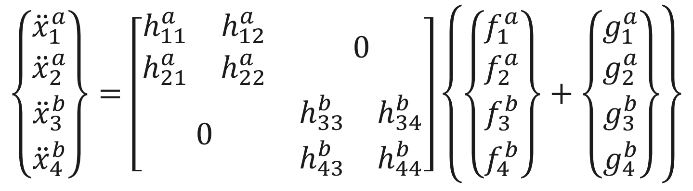
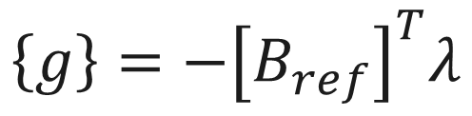
Defining the LM-FBS Compatibility Condition
The LM-FBS derivation is the same as before, but with a change in how we express the compatibility condition
$$\left\{\begin{matrix}\begin{matrix}{\ddot{x}}_{1}^{a} \\ {\ddot{x}}_{2}^{a}\end{matrix} \\ \begin{matrix}{\ddot{x}}_{3}^{b} \\ {\ddot{x}}_{4}^{b}\end{matrix}\end{matrix}\right\}=\left[\begin{matrix}\begin{matrix}h_{11}^{a} & h_{12}^{a} \\ h_{21}^{a} & h_{22}^{a}\end{matrix} & 0 \\ 0 & \begin{matrix}h_{33}^{b} & h_{34}^{b} \\ h_{43}^{b} & h_{44}^{b}\end{matrix}\end{matrix}\right]\left\{\left\{\begin{matrix}\begin{matrix}f_{1}^{a} \\ f_{2}^{a}\end{matrix} \\ \begin{matrix}f_{3}^{b} \\ f_{4}^{b}\end{matrix}\end{matrix}\right\}+\left\{\begin{matrix}\begin{matrix}g_{1}^{a} \\ g_{2}^{a}\end{matrix} \\ \begin{matrix}g_{3}^{b} \\ g_{4}^{b}\end{matrix}\end{matrix}\right\}\right\}$$
Interface Compatibility
Force Equilibrium
$$\left[B_{res}\right]\left\{\ddot{x}\right\}=0$$
$$\left\{g\right\}=−{\left[B_{ref}\right]}^{T}λ$$

Slide 52




Making the B Matrices – Interface Compatibility
System A
System B
Interface Compatibility
Select a $B_{res}$ to enforce interface compatibility:
$$\begin{matrix}\left\{\begin{matrix}\begin{matrix}{\ddot{x}}_{1}^{a} \\ {\ddot{x}}_{2}^{a}\end{matrix} \\ \begin{matrix}{\ddot{x}}_{3}^{b} \\ {\ddot{x}}_{4}^{b}\end{matrix}\end{matrix}\right\} & → & \left\{\begin{matrix}\begin{matrix}0 \\ {\ddot{x}}_{3}^{b}\end{matrix} \\ \begin{matrix}{\ddot{x}}_{3}^{b} \\ 0\end{matrix}\end{matrix}\right\}\end{matrix}$$
$$\left[B_{res}\right]\left\{\ddot{x}\right\}=0$$
Which should be equivalent to applying this constraint:
$${\ddot{x}}_{3}^{b}−{\ddot{x}}_{2}^{a}=0$$

Slide 53

Making the B Matrices – Interface Compatibility
System A
System B
Interface Compatibility
Select a $B_{res}$ to enforce interface compatibility:
$$\begin{matrix}\left\{\begin{matrix}\begin{matrix}{\ddot{x}}_{1}^{a} \\ {\ddot{x}}_{2}^{a}\end{matrix} \\ \begin{matrix}{\ddot{x}}_{3}^{b} \\ {\ddot{x}}_{4}^{b}\end{matrix}\end{matrix}\right\} & → & \left\{\begin{matrix}\begin{matrix}0 \\ {\ddot{x}}_{3}^{b}\end{matrix} \\ \begin{matrix}{\ddot{x}}_{3}^{b} \\ 0\end{matrix}\end{matrix}\right\}\end{matrix}$$
$$\left[B_{res}\right]\left\{\ddot{x}\right\}=0$$
Which should be equivalent to applying this constraint:
$${\ddot{x}}_{3}^{b}−{\ddot{x}}_{2}^{a}=0$$
Negative sign could be flipped
$$\left[B_{res}\right]=\left\{\begin{matrix}\begin{matrix}0 & −1\end{matrix} & \begin{matrix}1 & 0\end{matrix}\end{matrix}\right\}$$

Slide 54
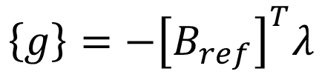

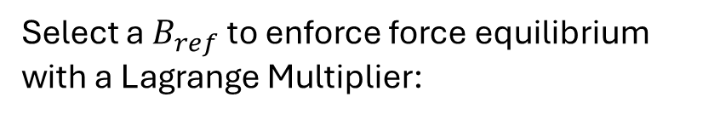

Making the B Matrices – Force Equilibrium
System A
System B
Force Equilibrium
Select a $B_{ref}$ to enforce force equilibrium with a Lagrange Multiplier:
$$\begin{matrix}\left\{\begin{matrix}\begin{matrix}g_{1}^{a} \\ g_{2}^{a}\end{matrix} \\ \begin{matrix}g_{3}^{b} \\ g_{4}^{b}\end{matrix}\end{matrix}\right\} & → & \left\{\begin{matrix}\begin{matrix}0 \\ {−g}_{3}^{b}\end{matrix} \\ \begin{matrix}g_{3}^{b} \\ 0\end{matrix}\end{matrix}\right\}\end{matrix}$$
$$\left\{g\right\}=−{\left[B_{ref}\right]}^{T}λ$$
Where:
$$λ=g_{3}^{b}$$

Slide 55

Making the B Matrices – Force Equilibrium
System A
System B
Force Equilibrium
Select a $B_{ref}$ to enforce force equilibrium with a Lagrange Multiplier:
$$\begin{matrix}\left\{\begin{matrix}\begin{matrix}g_{1}^{a} \\ g_{2}^{a}\end{matrix} \\ \begin{matrix}g_{3}^{b} \\ g_{4}^{b}\end{matrix}\end{matrix}\right\} & → & \left\{\begin{matrix}\begin{matrix}0 \\ {−g}_{3}^{b}\end{matrix} \\ \begin{matrix}g_{3}^{b} \\ 0\end{matrix}\end{matrix}\right\}\end{matrix}$$
$$\left\{g\right\}=−{\left[B_{ref}\right]}^{T}λ$$
Where:
$$λ=g_{3}^{b}$$
Negative sign could be flipped
$$\left[B_{ref}\right]=\left\{\begin{matrix}\begin{matrix}0 & −1\end{matrix} & \begin{matrix}1 & 0\end{matrix}\end{matrix}\right\}$$

Slide 56

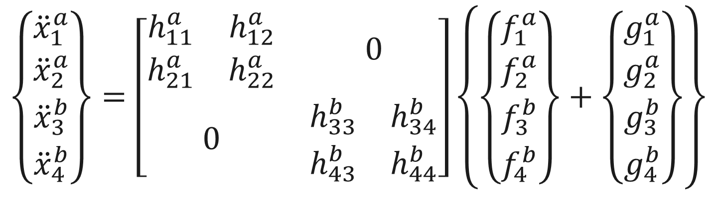

Deriving LM-FBS
$$\left\{\begin{matrix}\begin{matrix}{\ddot{x}}_{1}^{a} \\ {\ddot{x}}_{2}^{a}\end{matrix} \\ \begin{matrix}{\ddot{x}}_{3}^{b} \\ {\ddot{x}}_{4}^{b}\end{matrix}\end{matrix}\right\}=\left[\begin{matrix}\begin{matrix}h_{11}^{a} & h_{12}^{a} \\ h_{21}^{a} & h_{22}^{a}\end{matrix} & 0 \\ 0 & \begin{matrix}h_{33}^{b} & h_{34}^{b} \\ h_{43}^{b} & h_{44}^{b}\end{matrix}\end{matrix}\right]\left\{\left\{\begin{matrix}\begin{matrix}f_{1}^{a} \\ f_{2}^{a}\end{matrix} \\ \begin{matrix}f_{3}^{b} \\ f_{4}^{b}\end{matrix}\end{matrix}\right\}+\left\{\begin{matrix}\begin{matrix}g_{1}^{a} \\ g_{2}^{a}\end{matrix} \\ \begin{matrix}g_{3}^{b} \\ g_{4}^{b}\end{matrix}\end{matrix}\right\}\right\}$$
Interface Compatibility
Force Equilibrium
$$\left[B_{res}\right]\left\{\ddot{x}\right\}=0$$
$$\left\{g\right\}=−{\left[B_{ref}\right]}^{T}λ$$

Slide 57



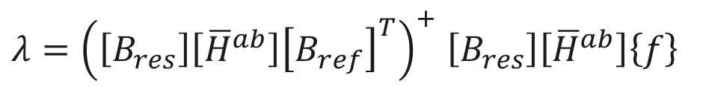
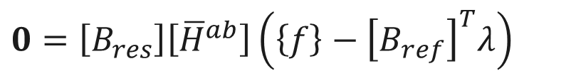
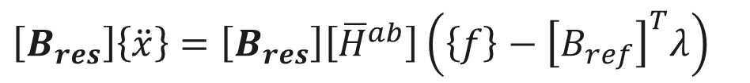
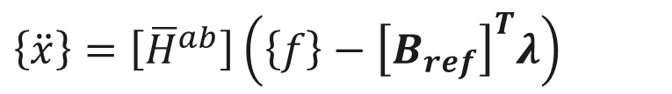

Deriving LM-FBS
1.)
$$\left\{\ddot{x}\right\}=\left[{\overline{H}}^{ab}\right]\left(\left\{f\right\}+\left\{g\right\}\right)$$
Starting point
$$\left\{\ddot{x}\right\}=\left[{\overline{H}}^{ab}\right]\left(\left\{f\right\}−{\left[B_{ref}\right]}^{T}λ\right)$$
2.)
$$\left[B_{res}\right]\left\{\ddot{x}\right\}=\left[B_{res}\right]\left[{\overline{H}}^{ab}\right]\left(\left\{f\right\}−{\left[B_{ref}\right]}^{T}λ\right)$$
3.)
$$0=\left[B_{res}\right]\left[{\overline{H}}^{ab}\right]\left(\left\{f\right\}−{\left[B_{ref}\right]}^{T}λ\right)$$
4.)
5.)
$$0=\left[B_{res}\right]\left[{\overline{H}}^{ab}\right]\left\{f\right\}−\left[B_{res}\right]\left[{\overline{H}}^{ab}\right]{\left[B_{ref}\right]}^{T}λ$$
6.)
$$\left[B_{res}\right]\left[{\overline{H}}^{ab}\right]\left\{f\right\} =\left[B_{res}\right]\left[{\overline{H}}^{ab}\right]{\left[B_{ref}\right]}^{T}λ$$
$λ={\left(\left[B_{res}\right]\left[{\overline{H}}^{ab}\right]{\left[B_{ref}\right]}^{T}\right)}^{+}$ $\left[B_{res}\right]\left[{\overline{H}}^{ab}\right]\left\{f\right\}$
7.)
8.)
$$\left\{\ddot{x}\right\}=\left[{\overline{H}}^{ab}\right]\left\{f\right\}−\left[{\overline{H}}^{ab}\right]{\left[B_{ref}\right]}^{T}λ$$
$\left\{\ddot{x}\right\}=\left[{\overline{H}}^{ab}\right]\left\{f\right\}−\left[{\overline{H}}^{ab}\right]{\left[B_{ref}\right]}^{T}$ ${\left(\left[B_{res}\right]\left[{\overline{H}}^{ab}\right]{\left[B_{ref}\right]}^{T}\right)}^{+}$ $\left[B\right]\left[{\overline{H}}^{ab}\right]\left\{f\right\}$
9.)
$$\left[H^{ab}\right]=\left[{\overline{H}}^{ab}\right]−\left[{\overline{H}}^{ab}\right]{\left[B_{ref}\right]}^{T} {\left(\left[B_{res}\right]\left[{\overline{H}}^{ab}\right]{\left[B_{ref}\right]}^{T}\right)}^{+} \left[B_{res}\right]\left[{\overline{H}}^{ab}\right]$$
10.)

Slide 58
Deriving LM-FBS
1.)
$$\left\{\ddot{x}\right\}=\left[{\overline{H}}^{ab}\right]\left(\left\{f\right\}+\left\{g\right\}\right)$$
$$\left\{\ddot{x}\right\}=\left[{\overline{H}}^{ab}\right]\left(\left\{f\right\}−{\left[B_{ref}\right]}^{T}λ\right)$$
2.)
Apply force equilibrium
$$\left[B_{res}\right]\left\{\ddot{x}\right\}=\left[B_{res}\right]\left[{\overline{H}}^{ab}\right]\left(\left\{f\right\}−{\left[B_{ref}\right]}^{T}λ\right)$$
3.)
$$0=\left[B_{res}\right]\left[{\overline{H}}^{ab}\right]\left(\left\{f\right\}−{\left[B_{ref}\right]}^{T}λ\right)$$
4.)
5.)
$$0=\left[B_{res}\right]\left[{\overline{H}}^{ab}\right]\left\{f\right\}−\left[B_{res}\right]\left[{\overline{H}}^{ab}\right]{\left[B_{ref}\right]}^{T}λ$$
6.)
$$\left[B_{res}\right]\left[{\overline{H}}^{ab}\right]\left\{f\right\} =\left[B_{res}\right]\left[{\overline{H}}^{ab}\right]{\left[B_{ref}\right]}^{T}λ$$
$λ={\left(\left[B_{res}\right]\left[{\overline{H}}^{ab}\right]{\left[B_{ref}\right]}^{T}\right)}^{+}$ $\left[B_{res}\right]\left[{\overline{H}}^{ab}\right]\left\{f\right\}$
7.)
8.)
$$\left\{\ddot{x}\right\}=\left[{\overline{H}}^{ab}\right]\left\{f\right\}−\left[{\overline{H}}^{ab}\right]{\left[B_{ref}\right]}^{T}λ$$
$\left\{\ddot{x}\right\}=\left[{\overline{H}}^{ab}\right]\left\{f\right\}−\left[{\overline{H}}^{ab}\right]{\left[B_{ref}\right]}^{T}$ ${\left(\left[B_{res}\right]\left[{\overline{H}}^{ab}\right]{\left[B_{ref}\right]}^{T}\right)}^{+}$ $\left[B\right]\left[{\overline{H}}^{ab}\right]\left\{f\right\}$
9.)
$$\left[H^{ab}\right]=\left[{\overline{H}}^{ab}\right]−\left[{\overline{H}}^{ab}\right]{\left[B_{ref}\right]}^{T} {\left(\left[B_{res}\right]\left[{\overline{H}}^{ab}\right]{\left[B_{ref}\right]}^{T}\right)}^{+} \left[B_{res}\right]\left[{\overline{H}}^{ab}\right]$$
10.)

Slide 59
Deriving LM-FBS
1.)
$$\left\{\ddot{x}\right\}=\left[{\overline{H}}^{ab}\right]\left(\left\{f\right\}+\left\{g\right\}\right)$$
$$\left\{\ddot{x}\right\}=\left[{\overline{H}}^{ab}\right]\left(\left\{f\right\}−{\left[B_{ref}\right]}^{T}λ\right)$$
2.)
$$\left[B_{res}\right]\left\{\ddot{x}\right\}=\left[B_{res}\right]\left[{\overline{H}}^{ab}\right]\left(\left\{f\right\}−{\left[B_{ref}\right]}^{T}λ\right)$$
Pre-multiply by the response B matrix
3.)
$$0=\left[B_{res}\right]\left[{\overline{H}}^{ab}\right]\left(\left\{f\right\}−{\left[B_{ref}\right]}^{T}λ\right)$$
4.)
5.)
$$0=\left[B_{res}\right]\left[{\overline{H}}^{ab}\right]\left\{f\right\}−\left[B_{res}\right]\left[{\overline{H}}^{ab}\right]{\left[B_{ref}\right]}^{T}λ$$
6.)
$$\left[B_{res}\right]\left[{\overline{H}}^{ab}\right]\left\{f\right\} =\left[B_{res}\right]\left[{\overline{H}}^{ab}\right]{\left[B_{ref}\right]}^{T}λ$$
$λ={\left(\left[B_{res}\right]\left[{\overline{H}}^{ab}\right]{\left[B_{ref}\right]}^{T}\right)}^{+}$ $\left[B_{res}\right]\left[{\overline{H}}^{ab}\right]\left\{f\right\}$
7.)
8.)
$$\left\{\ddot{x}\right\}=\left[{\overline{H}}^{ab}\right]\left\{f\right\}−\left[{\overline{H}}^{ab}\right]{\left[B_{ref}\right]}^{T}λ$$
$\left\{\ddot{x}\right\}=\left[{\overline{H}}^{ab}\right]\left\{f\right\}−\left[{\overline{H}}^{ab}\right]{\left[B_{ref}\right]}^{T}$ ${\left(\left[B_{res}\right]\left[{\overline{H}}^{ab}\right]{\left[B_{ref}\right]}^{T}\right)}^{+}$ $\left[B\right]\left[{\overline{H}}^{ab}\right]\left\{f\right\}$
9.)
$$\left[H^{ab}\right]=\left[{\overline{H}}^{ab}\right]−\left[{\overline{H}}^{ab}\right]{\left[B_{ref}\right]}^{T} {\left(\left[B_{res}\right]\left[{\overline{H}}^{ab}\right]{\left[B_{ref}\right]}^{T}\right)}^{+} \left[B_{res}\right]\left[{\overline{H}}^{ab}\right]$$
10.)

Slide 60
Deriving LM-FBS
1.)
$$\left\{\ddot{x}\right\}=\left[{\overline{H}}^{ab}\right]\left(\left\{f\right\}+\left\{g\right\}\right)$$
$$\left\{\ddot{x}\right\}=\left[{\overline{H}}^{ab}\right]\left(\left\{f\right\}−{\left[B_{ref}\right]}^{T}λ\right)$$
2.)
$$\left[B_{res}\right]\left\{\ddot{x}\right\}=\left[B_{res}\right]\left[{\overline{H}}^{ab}\right]\left(\left\{f\right\}−{\left[B_{ref}\right]}^{T}λ\right)$$
3.)
$$0=\left[B_{res}\right]\left[{\overline{H}}^{ab}\right]\left(\left\{f\right\}−{\left[B_{ref}\right]}^{T}λ\right)$$
4.)
5.)
$$0=\left[B_{res}\right]\left[{\overline{H}}^{ab}\right]\left\{f\right\}−\left[B_{res}\right]\left[{\overline{H}}^{ab}\right]{\left[B_{ref}\right]}^{T}λ$$
Apply Interface compatibility and solve for λ
6.)
$$\left[B_{res}\right]\left[{\overline{H}}^{ab}\right]\left\{f\right\} =\left[B_{res}\right]\left[{\overline{H}}^{ab}\right]{\left[B_{ref}\right]}^{T}λ$$
$λ={\left(\left[B_{res}\right]\left[{\overline{H}}^{ab}\right]{\left[B_{ref}\right]}^{T}\right)}^{+}$ $\left[B_{res}\right]\left[{\overline{H}}^{ab}\right]\left\{f\right\}$
7.)
8.)
$$\left\{\ddot{x}\right\}=\left[{\overline{H}}^{ab}\right]\left\{f\right\}−\left[{\overline{H}}^{ab}\right]{\left[B_{ref}\right]}^{T}λ$$
$\left\{\ddot{x}\right\}=\left[{\overline{H}}^{ab}\right]\left\{f\right\}−\left[{\overline{H}}^{ab}\right]{\left[B_{ref}\right]}^{T}$ ${\left(\left[B_{res}\right]\left[{\overline{H}}^{ab}\right]{\left[B_{ref}\right]}^{T}\right)}^{+}$ $\left[B\right]\left[{\overline{H}}^{ab}\right]\left\{f\right\}$
9.)
$$\left[H^{ab}\right]=\left[{\overline{H}}^{ab}\right]−\left[{\overline{H}}^{ab}\right]{\left[B_{ref}\right]}^{T} {\left(\left[B_{res}\right]\left[{\overline{H}}^{ab}\right]{\left[B_{ref}\right]}^{T}\right)}^{+} \left[B_{res}\right]\left[{\overline{H}}^{ab}\right]$$
10.)

Slide 61
Deriving LM-FBS
1.)
$$\left\{\ddot{x}\right\}=\left[{\overline{H}}^{ab}\right]\left(\left\{f\right\}+\left\{g\right\}\right)$$
$$\left\{\ddot{x}\right\}=\left[{\overline{H}}^{ab}\right]\left(\left\{f\right\}−{\left[B_{ref}\right]}^{T}λ\right)$$
2.)
$$\left[B_{res}\right]\left\{\ddot{x}\right\}=\left[B_{res}\right]\left[{\overline{H}}^{ab}\right]\left(\left\{f\right\}−{\left[B_{ref}\right]}^{T}λ\right)$$
3.)
$$0=\left[B_{res}\right]\left[{\overline{H}}^{ab}\right]\left(\left\{f\right\}−{\left[B_{ref}\right]}^{T}λ\right)$$
4.)
5.)
$$0=\left[B_{res}\right]\left[{\overline{H}}^{ab}\right]\left\{f\right\}−\left[B_{res}\right]\left[{\overline{H}}^{ab}\right]{\left[B_{ref}\right]}^{T}λ$$
Apply the solved λ to the equation from step two and extract the coupled FRFs
6.)
$$\left[B_{res}\right]\left[{\overline{H}}^{ab}\right]\left\{f\right\} =\left[B_{res}\right]\left[{\overline{H}}^{ab}\right]{\left[B_{ref}\right]}^{T}λ$$
$λ={\left(\left[B_{res}\right]\left[{\overline{H}}^{ab}\right]{\left[B_{ref}\right]}^{T}\right)}^{+}$ $\left[B_{res}\right]\left[{\overline{H}}^{ab}\right]\left\{f\right\}$
7.)
8.)
$$\left\{\ddot{x}\right\}=\left[{\overline{H}}^{ab}\right]\left\{f\right\}−\left[{\overline{H}}^{ab}\right]{\left[B_{ref}\right]}^{T}λ$$
$\left\{\ddot{x}\right\}=\left[{\overline{H}}^{ab}\right]\left\{f\right\}−\left[{\overline{H}}^{ab}\right]{\left[B_{ref}\right]}^{T}$ ${\left(\left[B_{res}\right]\left[{\overline{H}}^{ab}\right]{\left[B_{ref}\right]}^{T}\right)}^{+}$ $\left[B\right]\left[{\overline{H}}^{ab}\right]\left\{f\right\}$
9.)
$$\left[H^{ab}\right]=\left[{\overline{H}}^{ab}\right]−\left[{\overline{H}}^{ab}\right]{\left[B_{ref}\right]}^{T} {\left(\left[B_{res}\right]\left[{\overline{H}}^{ab}\right]{\left[B_{ref}\right]}^{T}\right)}^{+} \left[B_{res}\right]\left[{\overline{H}}^{ab}\right]$$
10.)

Slide 62
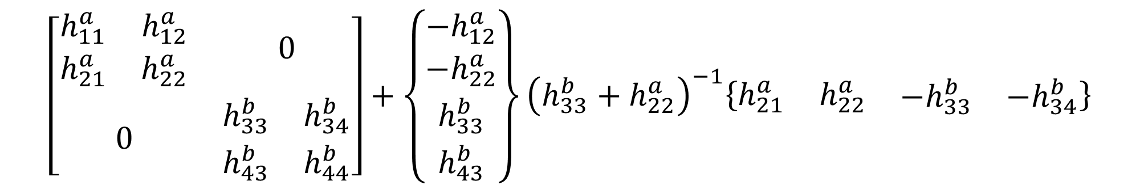
Comparing LM-FBS and the Basic Derivation
LM-FBS and the basic derivation result in the same equations, with the same patterns
$$\left[{\overline{H}}^{ab}\right]−\left[{\overline{H}}^{ab}\right]{\left[B_{ref}\right]}^{T} {\left(\left[B_{res}\right]\left[{\overline{H}}^{ab}\right]{\left[B_{ref}\right]}^{T}\right)}^{+} \left[B_{res}\right]\left[{\overline{H}}^{ab}\right]$$
$$\left[\begin{matrix}\begin{matrix}h_{11}^{a} & h_{12}^{a} \\ h_{21}^{a} & h_{22}^{a}\end{matrix} & 0 \\ 0 & \begin{matrix}h_{33}^{b} & h_{34}^{b} \\ h_{43}^{b} & h_{44}^{b}\end{matrix}\end{matrix}\right]+\left\{\begin{matrix}\begin{matrix}−h_{12}^{a} \\ −h_{22}^{a}\end{matrix} \\ \begin{matrix}h_{33}^{b} \\ h_{43}^{b}\end{matrix}\end{matrix}\right\}{\left(h_{33}^{b}+h_{22}^{a}\right)}^{−1}\left\{\begin{matrix}\begin{matrix}h_{21}^{a} & h_{22}^{a}\end{matrix} & \begin{matrix}−h_{33}^{b} & −h_{34}^{b}\end{matrix}\end{matrix}\right\}$$

Slide 63
LM-FBS – Lagrange Multipliers

Slide 64
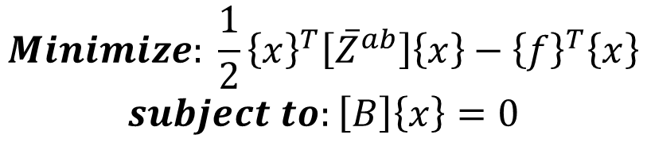
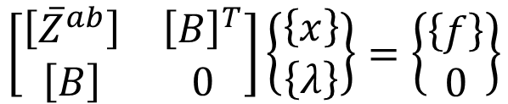



LM-FBS as a Constrained Optimization
$$Minimize: \frac{1}{2}{\left\{x\right\}}^{T}\left[{\overline{Z}}^{ab}\right]\left\{x\right\}−{\left\{f\right\}}^{T}\left\{x\right\}$$
$$subject to:\left[B\right]\left\{x\right\}=0$$
Quadratic program (akin to Lagrangian mechanics)
$$\left[\begin{matrix}\left[{\overline{Z}}^{ab}\right] & {\left[B\right]}^{T} \\ \left[B\right] & 0\end{matrix}\right]\left\{\begin{matrix}\left\{x\right\} \\ \left\{λ\right\}\end{matrix}\right\}=\left\{\begin{matrix}\left\{f\right\} \\ 0\end{matrix}\right\}$$
KKT system with Lagrange Multipliers
$$\left[{\overline{Z}}^{ab}\right]\left\{x\right\}+{\left[B\right]}^{T}\left\{λ\right\}=\left\{f\right\}$$
Extracting the first row from the KKT system
$$\left[{\overline{Z}}^{ab}\right]\left\{x\right\}=\left\{f\right\}−{\left[B\right]}^{T}\left\{λ\right\}$$
$$\left\{x\right\}=\left[{\overline{H}}^{ab}\right]\left(\left\{f\right\}−{\left[B\right]}^{T}\left\{λ\right\}\right)$$
Converting from dynamic impedance to FRFs

Slide 65
LM-FBS as a Constrained Optimization
$$Minimize: \frac{1}{2}{\left\{x\right\}}^{T}\left[{\overline{Z}}^{ab}\right]\left\{x\right\}−{\left\{f\right\}}^{T}\left\{x\right\}$$
$$subject to:\left[B\right]\left\{x\right\}=0$$
Quadratic program (akin to Lagrangian mechanics)
$$\left[\begin{matrix}\left[{\overline{Z}}^{ab}\right] & {\left[B\right]}^{T} \\ \left[B\right] & 0\end{matrix}\right]\left\{\begin{matrix}\left\{x\right\} \\ \left\{λ\right\}\end{matrix}\right\}=\left\{\begin{matrix}\left\{f\right\} \\ 0\end{matrix}\right\}$$
KKT system with Lagrange Multipliers
$$\left[{\overline{Z}}^{ab}\right]\left\{x\right\}+{\left[B\right]}^{T}\left\{λ\right\}=\left\{f\right\}$$
Extracting the first row from the KKT system
$$\left[{\overline{Z}}^{ab}\right]\left\{x\right\}=\left\{f\right\}−{\left[B\right]}^{T}\left\{λ\right\}$$
$$\left\{x\right\}=\left[{\overline{H}}^{ab}\right]\left(\left\{f\right\}−{\left[B\right]}^{T}\left\{λ\right\}\right)$$
Converting from dynamic impedance to FRFs

Slide 66
LM-FBS as a Constrained Optimization
$$Minimize: \frac{1}{2}{\left\{x\right\}}^{T}\left[{\overline{Z}}^{ab}\right]\left\{x\right\}−{\left\{f\right\}}^{T}\left\{x\right\}$$
$$subject to:\left[B\right]\left\{x\right\}=0$$
Quadratic program (akin to Lagrangian mechanics)
$$\left[\begin{matrix}\left[{\overline{Z}}^{ab}\right] & {\left[B\right]}^{T} \\ \left[B\right] & 0\end{matrix}\right]\left\{\begin{matrix}\left\{x\right\} \\ \left\{λ\right\}\end{matrix}\right\}=\left\{\begin{matrix}\left\{f\right\} \\ 0\end{matrix}\right\}$$
KKT system with Lagrange Multipliers
$$\left[{\overline{Z}}^{ab}\right]\left\{x\right\}+{\left[B\right]}^{T}\left\{λ\right\}=\left\{f\right\}$$
Extracting the first row from the KKT system
$$\left[{\overline{Z}}^{ab}\right]\left\{x\right\}=\left\{f\right\}−{\left[B\right]}^{T}\left\{λ\right\}$$
$$\left\{x\right\}=\left[{\overline{H}}^{ab}\right]\left(\left\{f\right\}−{\left[B\right]}^{T}\left\{λ\right\}\right)$$
Converting from dynamic impedance to FRFs

Slide 67
LM-FBS as a Constrained Optimization
$$Minimize: \frac{1}{2}{\left\{x\right\}}^{T}\left[{\overline{Z}}^{ab}\right]\left\{x\right\}−{\left\{f\right\}}^{T}\left\{x\right\}$$
$$subject to:\left[B\right]\left\{x\right\}=0$$
Quadratic program (akin to Lagrangian mechanics)
$$\left[\begin{matrix}\left[{\overline{Z}}^{ab}\right] & {\left[B\right]}^{T} \\ \left[B\right] & 0\end{matrix}\right]\left\{\begin{matrix}\left\{x\right\} \\ \left\{λ\right\}\end{matrix}\right\}=\left\{\begin{matrix}\left\{f\right\} \\ 0\end{matrix}\right\}$$
KKT system with Lagrange Multipliers
$$\left[{\overline{Z}}^{ab}\right]\left\{x\right\}+{\left[B\right]}^{T}\left\{λ\right\}=\left\{f\right\}$$
Extracting the first row from the KKT system
$$\left[{\overline{Z}}^{ab}\right]\left\{x\right\}=\left\{f\right\}−{\left[B\right]}^{T}\left\{λ\right\}$$
$$\left\{x\right\}=\left[{\overline{H}}^{ab}\right]\left(\left\{f\right\}−{\left[B\right]}^{T}\left\{λ\right\}\right)$$
Converting from dynamic impedance to FRFs

Slide 68
Data Requirements for FBS

Slide 69
Data Requirements for FBS
System A
System B
Need enough response and reference DOFs to fully define the coupling condition – rotations matter
Extra response and reference DOFs can be added, depending on how we want to model the system

Slide 70
FBS Summary

Slide 71
FBS - Summary
Conversion to the frequency domain means that the substructuring problem can be solved with basic linear algebra
LM-FBS should be used in practice – note that some literature will use different names for the same method
The B matrices in LM-FBS can be slightly different than other substructuring domains, depending on the response and reference DOFs that exist in the FRFs
Need reference and responses to define the coupling condition, everything else is up to the practitioner

Slide 72
FBS - Summary
Conversion to the frequency domain means that the substructuring problem can be solved with basic linear algebra
LM-FBS should be used in practice – note that some literature will use different names for the same method
The B matrices in LM-FBS can be slightly different than other substructuring domains, depending on the response and reference DOFs that exist in the FRFs
Need reference and responses to define the coupling condition, everything else is up to the practitioner

Slide 73
FBS - Summary
Conversion to the frequency domain means that the substructuring problem can be solved with basic linear algebra
LM-FBS should be used in practice – note that some literature will use different names for the same method
The B matrices in LM-FBS can be slightly different than other substructuring domains, depending on the response and reference DOFs that exist in the FRFs
Need reference and responses to define the coupling condition, everything else is up to the practitioner

Slide 74
FBS - Summary
Conversion to the frequency domain means that the substructuring problem can be solved with basic linear algebra
LM-FBS should be used in practice – note that some literature will use different names for the same method
The B matrices in LM-FBS can be slightly different than other substructuring domains, depending on the response and reference DOFs that exist in the FRFs
Need reference and responses to define the coupling condition, everything else is up to the practitioner

Slide 75
Next Up: Component Mode Synthesis

